Slide 1
LibEr E-Commerce Book Store
Scott Pelletier & Dongguo Wu

Slide 2
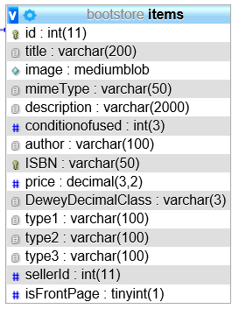
Database Structure: Items
Extra columns for sorting and categorization
Blob image storage*

Slide 3
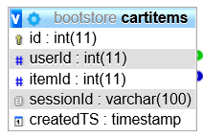
Database Structure: Cart
Persistent cart for registered users
Transitory cart for unregistered users
Items will reflect seller edits up until time of sale

Slide 4
User Cart Cart.html

Slide 5
Main Page: index.html

Slide 6
Bootstrap: Columniation
<div class="row">
<div class="col-sm-4">
<!-- -->
</div>
<div class="col-sm-6">
<!-- -->
</div>
<div class="col-sm-4">
<!-- -->
</div>
</div>

Slide 7
Pagination

Slide 8
DeweyDecimalClass

Slide 9


Still to Come
Google Analytics
PayPal Checkout

